Slide 1


Group 5: Face Recognition Sign-In System
何沛霖 1809853U-I011-0078
陈睿 1809853Z-I011-0017
王雨阳 1809853Z-I011-0045
陈宇轩 1809853J-I011-0011
CS003 PROJECTS ON SOFTWARE ENGINEERING

Slide 2
CONTENTS
PART 01
Requirement
PART 02
Design
PART 03
Development
PART 04
Testing
PART 05
Management

Slide 3
Requirement
Existed Problems
Background Info
Environment & System Modules
Functional Requirements
Non-functional Requirements

Slide 4

Existed Problems
Existed Problems
Traditional sign-in tools, like WeMust app, is easy to forget, our software seems more direct and convenient.
WeMust cannot record the leaving time of students, some students may leave the class in the halfway, which is not allowed.
The problem of signing in with a fake face may take place in some sign-in system, but our sign-in system has relatively high recognition rate.
Sometimes app maintenance will effect the normal usage. But the independent software may reduce the impact.

Slide 5
Background Info
Background Info
Face recognition technology based on deep learning is mature enough so that it is now widely used in banks, companies, customs and universities.
There seems to be no such a sign-in system by using face in our campus. And our team expects to be a pioneer and contributes. We hope that our software can solve the existed problems.

Slide 6
Environment & System Modules
Environment & System Models
Environment
Cross-platform, mainly for Windows
Client Model
Registration Module
Sign-in Module
Statistics Module
Webpage Model
Administrator Login Module
Record Display Module
Retroactive Module

Slide 7
Functional Requirements
Functional Requirements
Registration
A button for registration
Enter student id, name and take a photo
Alert or tips (when error occurs)
Sign-in Identification
A button for identification
Take a photo and recognition, if yes then successfully sign in
Both success and failure with dialog message
Record Display
Administrator (teacher) can login the website, check sign-in results and do retroactive sign-in
The client should plot student number and attendance/absence rate

Slide 8
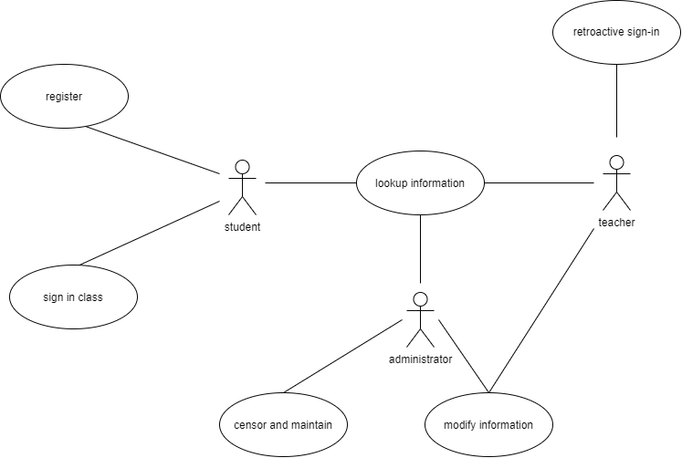
Functional Requirements
Use Case Diagram

Slide 9
Non-functional Requirements
Non-functional Requirements
Environment and Platform Requirements
Language : Python 3.7 (Anaconda)
Frontend framework : Django
Supported browsers (not Beta) : Chrome, Firefox, Microsoft Edge, Safari
Backend database : SQLite3
Client UI : PyQt5
Cloud Server Deployment (recommended but not compulsory) : Alibaba Cloud
Quality Requirements
Database capacity : Around 3000 lines of data (lite)
Quick response and low delay : < 1 second
Internet bandwidth : 5 Mbps for upload, 5 Mbps for download
Regular maintenance
Stability and security
Process Requirements
Programming thinking : OOP
Open-source platform for process supervision : Github
Plan period : 8 weeks

Slide 10
Design
Purpose
General Priority
Design Outline
Major Design Issue
Other Details

Slide 11
Purpose
Purpose
Client Design
Registration
Identification
Record Display
Website Design
Record Display
Retroactive Sign-in

Slide 12
General Priority
General Priority
Device Priority
IDE : Pycharm
Exterior device : camera
CPU efficiency : >= 800M
Network bandwidth efficiency : Upload (5 Mbps), Download (5 Mbps)
Memory efficiency : Must <= 200MB RAM.
Required memory : 128M
System Priority
Security : SSH and users' privilege licence
Maintainability : Small data capacity, limited throughput
Portability : Website supports different browsers, client software (200MB) supports different OSs

Slide 13
Design Outline
Design Outline
Architecture
General view of client & website
Class
Class diagram of client
Sequence
Sequence diagram of client
Functionality
Basic functionality for client and website

Slide 14
Major Design Issue
Major Design Issue
Face Recognition
Accuracy of cognition - comparing APIs and modules which are referred by Github repositories
Scenario - Considering the trained dataset in the modules whether reach practical scenarios
Specific factors of environment - such as shadow, light source, masks and glasses that students wearing
Registration and Storage
Stability of database, designing with less coupling (data couple) and more reusable, increase cohesion
Flexible interface for administrators to modify and update
Particular authorities for administrators (teachers) to manage

Slide 15
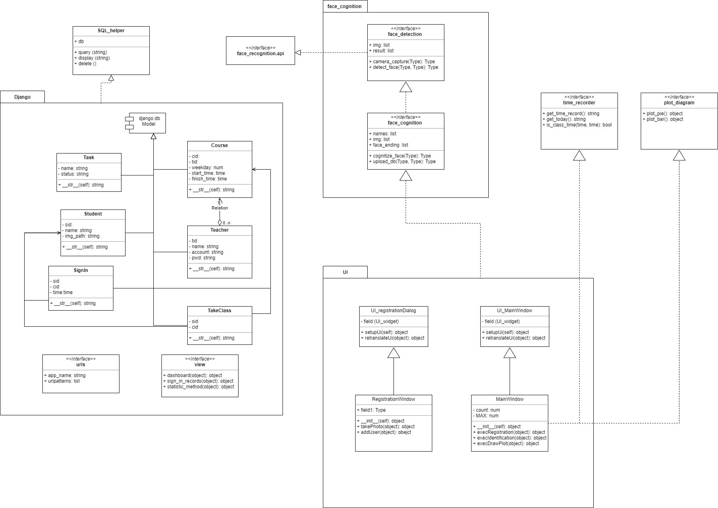
Other Details
Class Diagram

Slide 16
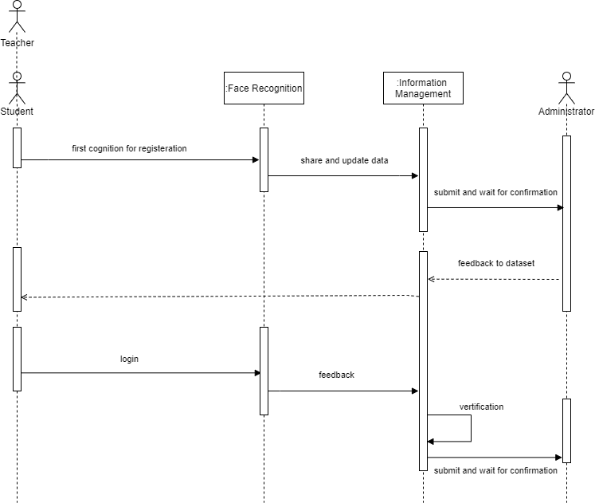
Other Details
Sequence Diagram

Slide 17
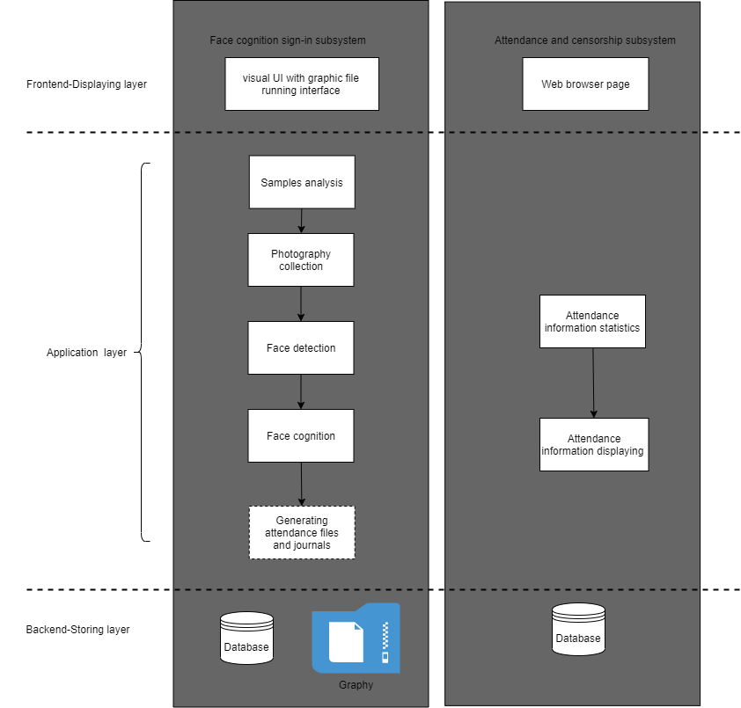
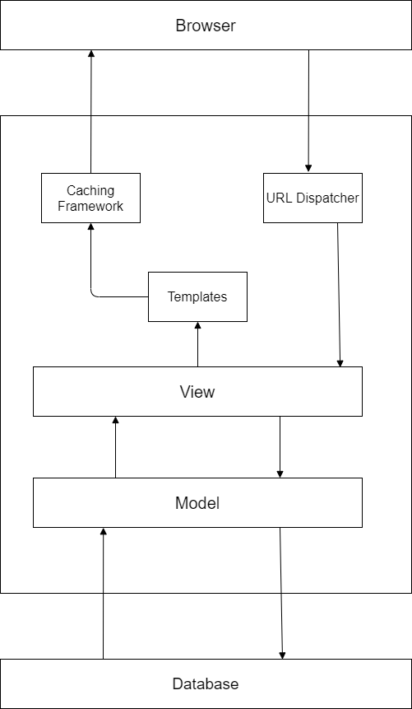
Other Details
Multi-layer Architecture Pattern

Slide 18
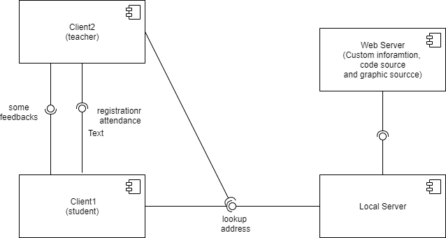
Other Details
Client-Service and Distributed Architectural Pattern

Slide 19
Development
Scrum Roles
Meetings
Leangoo
Project

Slide 20
Scrum Roles
Product Owner
Peilin He
Scrum Master
Yuyang Wang
Scrum Roles
(Egoless team)
Developer Team
Rui Chen (Developer)
Yuxuan Chen (Maintainer)
Notes:
Product Owner:
确认产品目标、明确产品需求
确保product backlog是透明、易懂
Scrum Master :
根据scrum的指引构建scrum
确认每个人都明白scrum该做什么
Developer :
完成开发任务
Maintainer :
测试、维护、developer一起debug，以及标记有风险的部分

Slide 21
Meetings
4 Meetings
Daily Standing Meeting
Planning Meeting
Work progress, Current Issue, Plan, etc.
Requirement, Design, Duration,
Roadmap, Milestone, Sprint & Task
Demo Meeting
Retrospective Meeting
Demonstration, Communication, Confirmation
Rethink, Summarization, Improvement, Pros & Cons
Notes:
Daily Standing Meeting
大家互相汇报工作进度，目前遇到的问题，以及工作计划
Planning Meeting
PO, Scrum Master确定roadmap，milestone，根据milestone组成sprint
在每个sprint开始前召开，PO, Scrum Master 与 Developer Team 交流，确定技术路线和明确任务规划以及时长
Demo Meeting
開發團隊展示他的成果，展示测试和开发结果
Po和SM确认开发人员的工作和用户需求相同
Retrospective Meeting
大家会反思、总结上一个sprint，并且在下一个sprint做一些改进

Slide 22
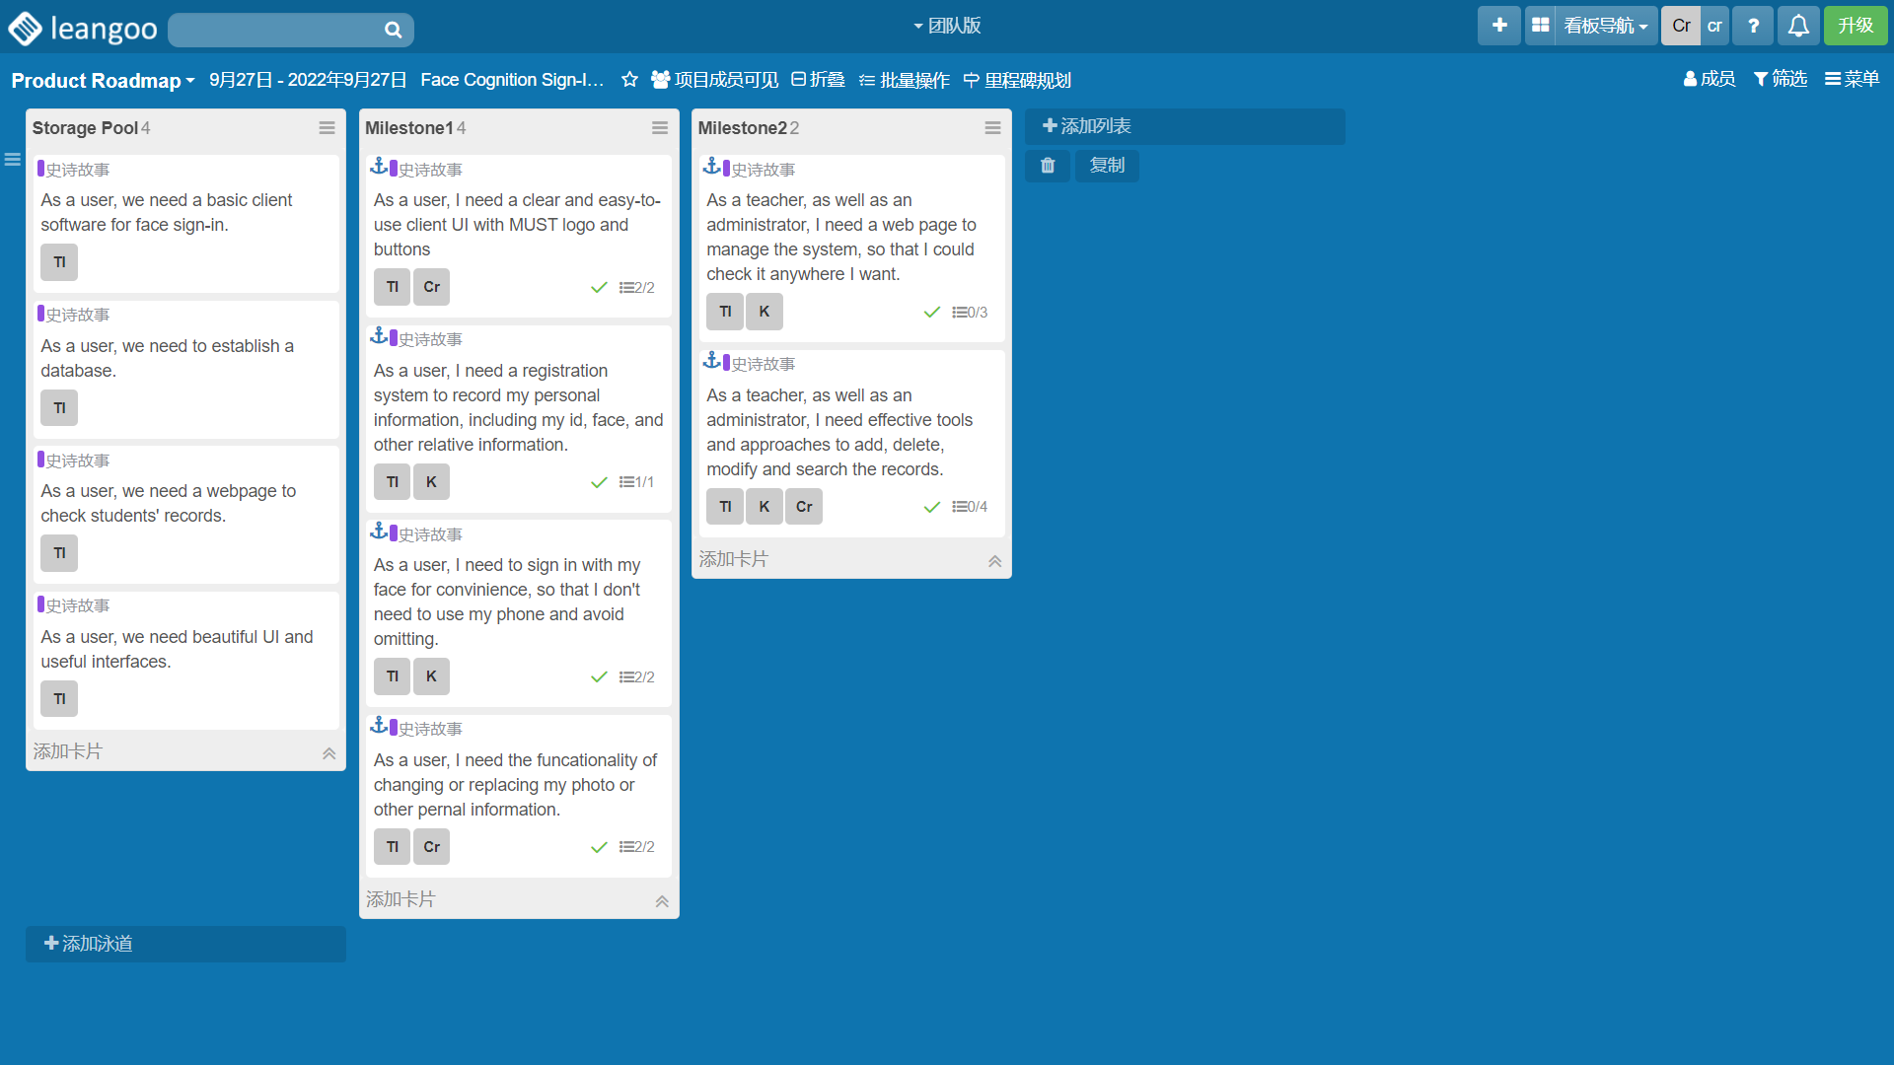
Leangoo – Product Roadmap
Planning Meeting

Slide 23
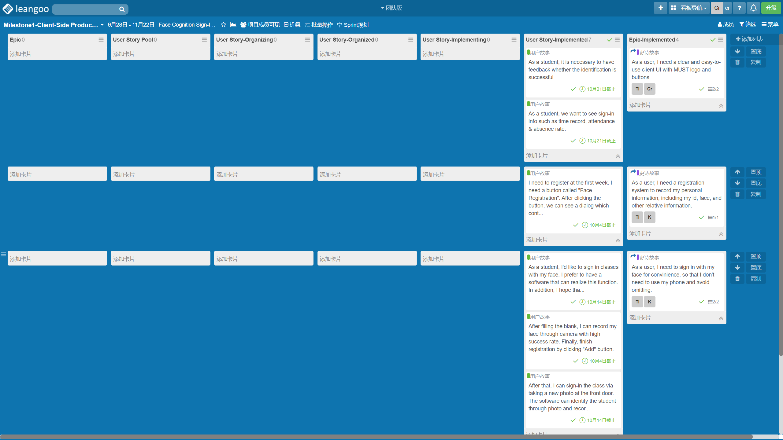
Leangoo – Milestone 1: Client-Side Product Backlog
Planning Meeting

Slide 24
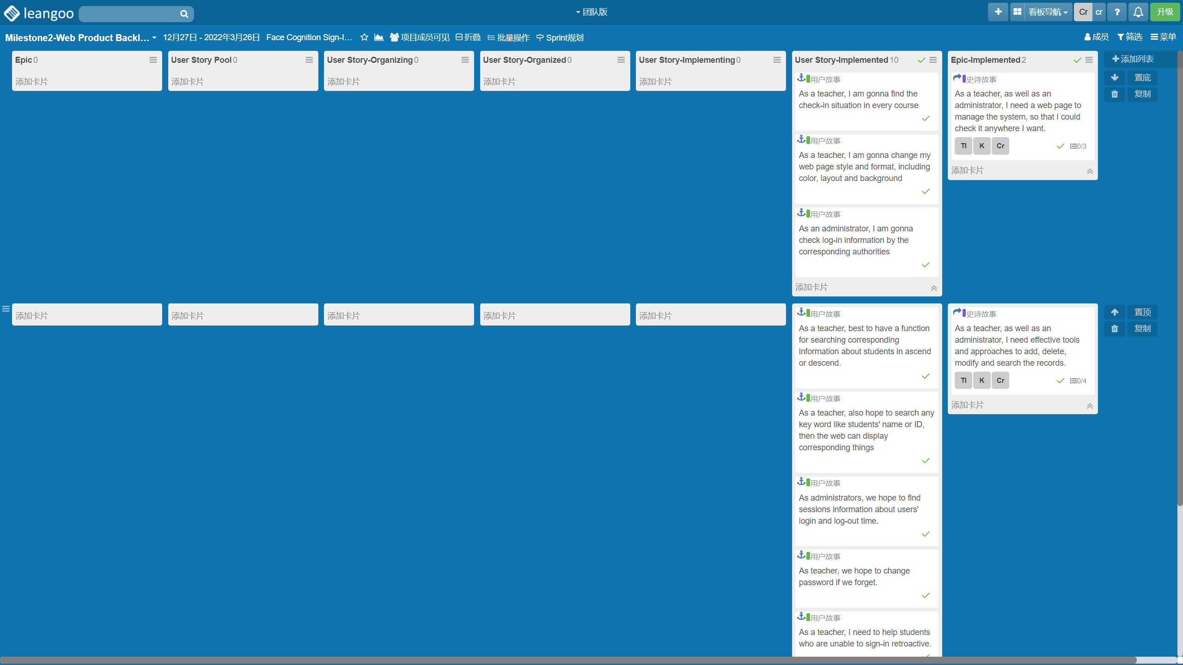
Leangoo – Milestone 2: Web Product Backlog
Planning Meeting

Slide 25
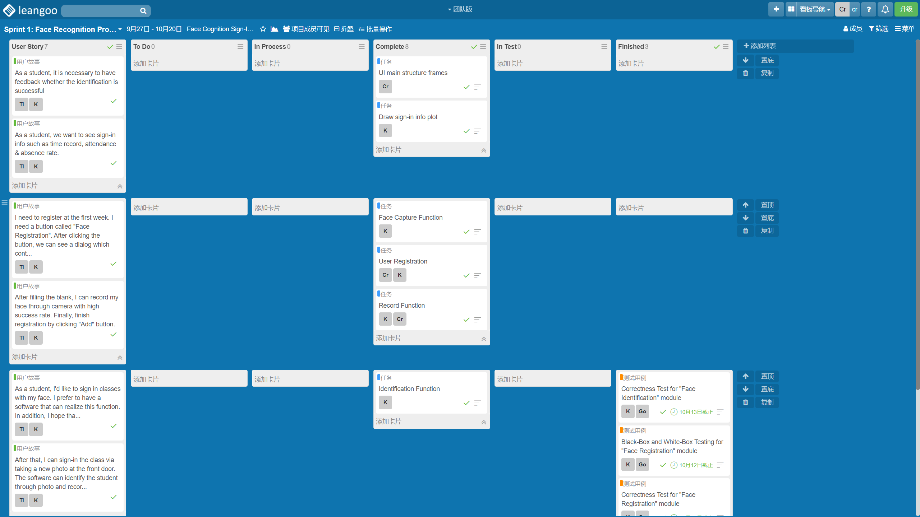
Leangoo – Sprint 1: Face Recognition Prototype
Daily Standing Meeting

Slide 26
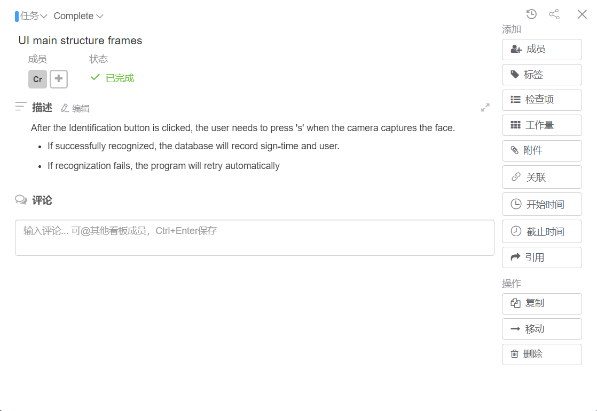
Leangoo – Sprint 1: Face Recognition Prototype

Slide 27
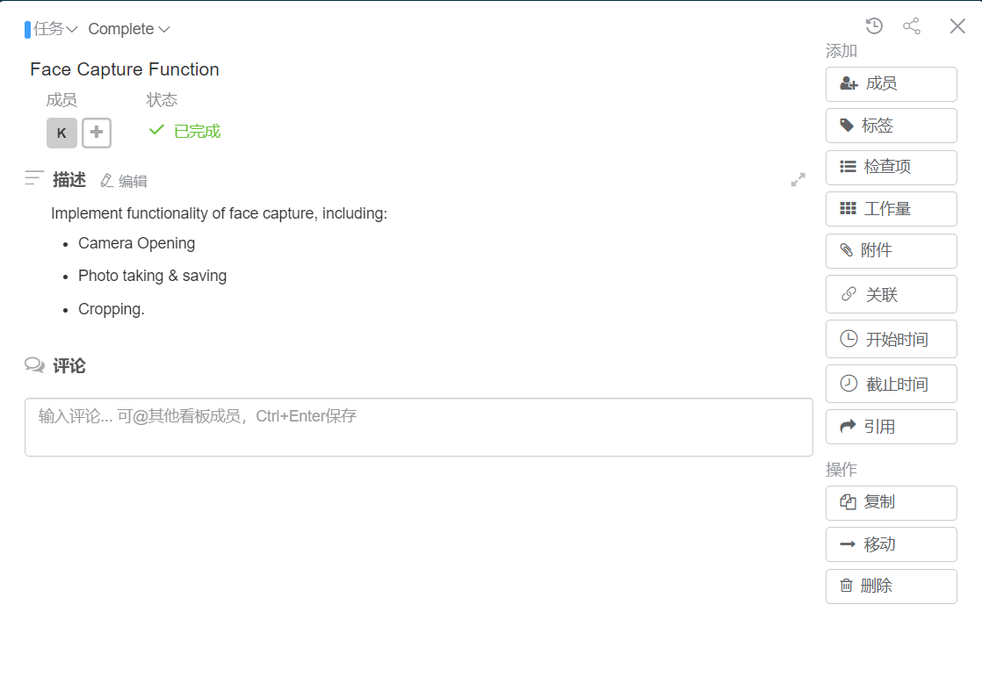
Leangoo – Sprint 1: Face Recognition Prototype

Slide 28
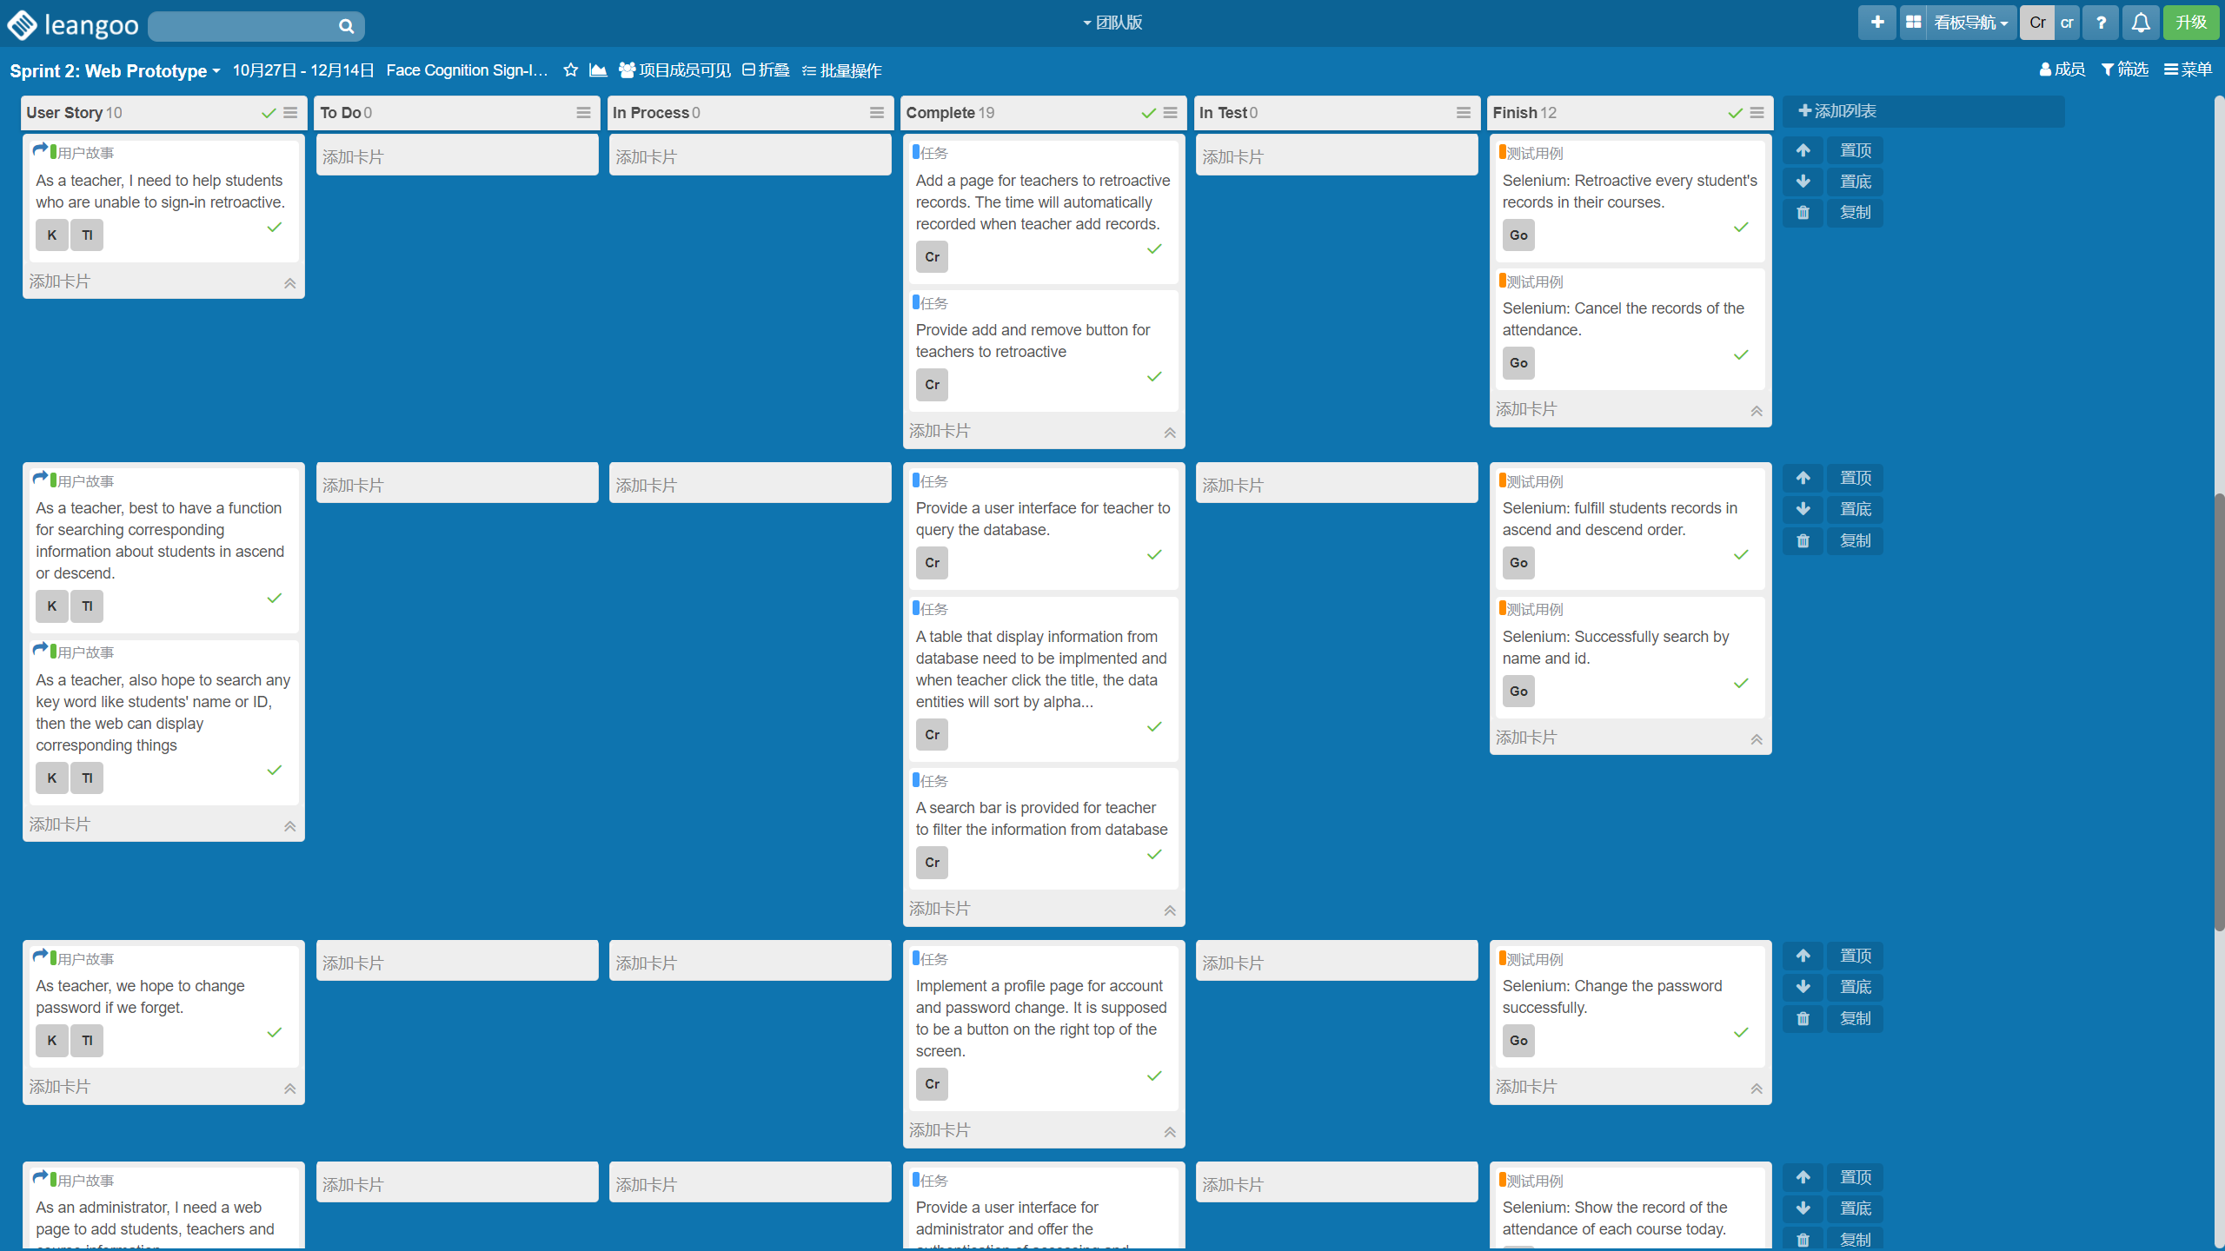
Leangoo – Sprint 2: Web Prototype
Daily Standing Meeting

Slide 29
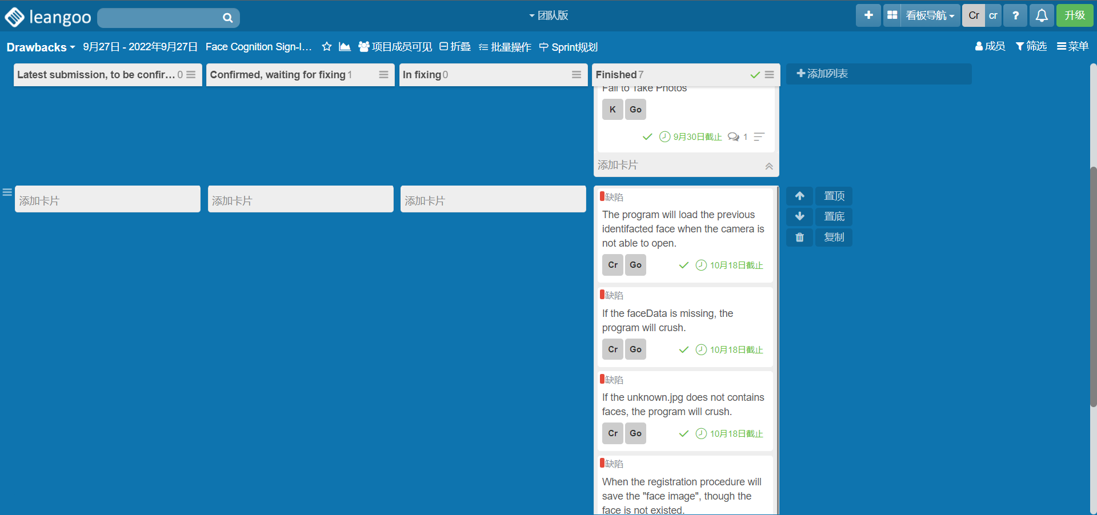
Leangoo – Drawbacks
Daily Standing Meeting

Slide 30
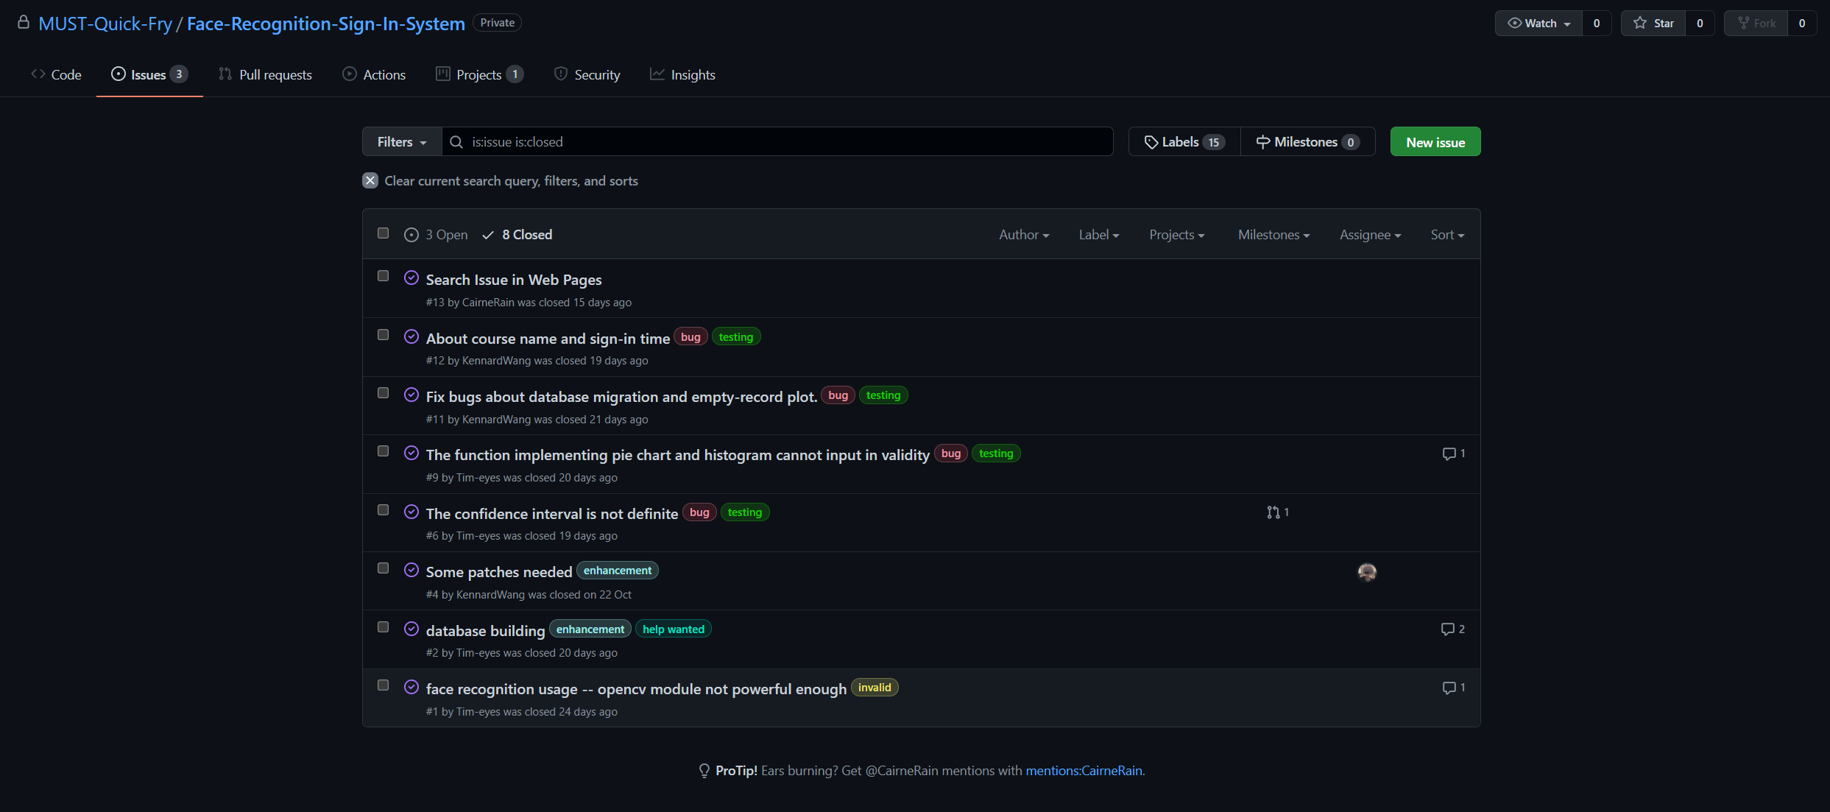
Leangoo – Drawbacks

Slide 31
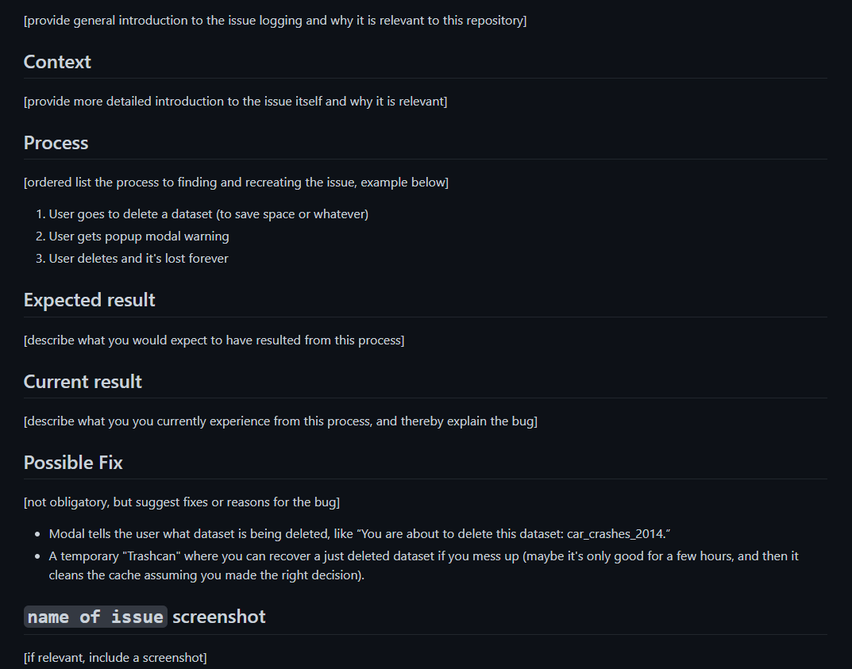
Leangoo – Drawbacks
Issue Report Template

Slide 32
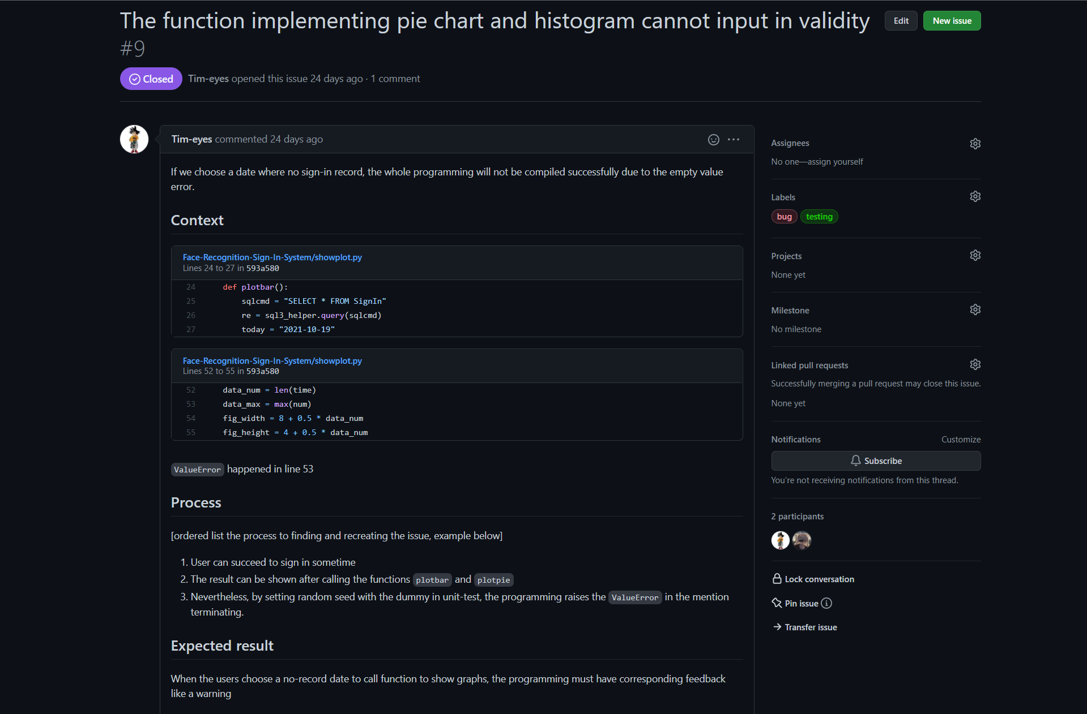
Leangoo – Drawbacks

Slide 33
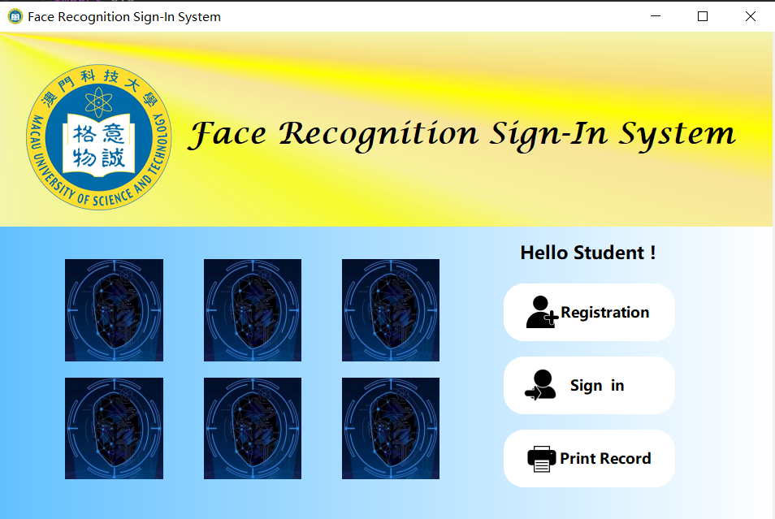
Project
Demo Meeting – Sprint 1

Slide 34
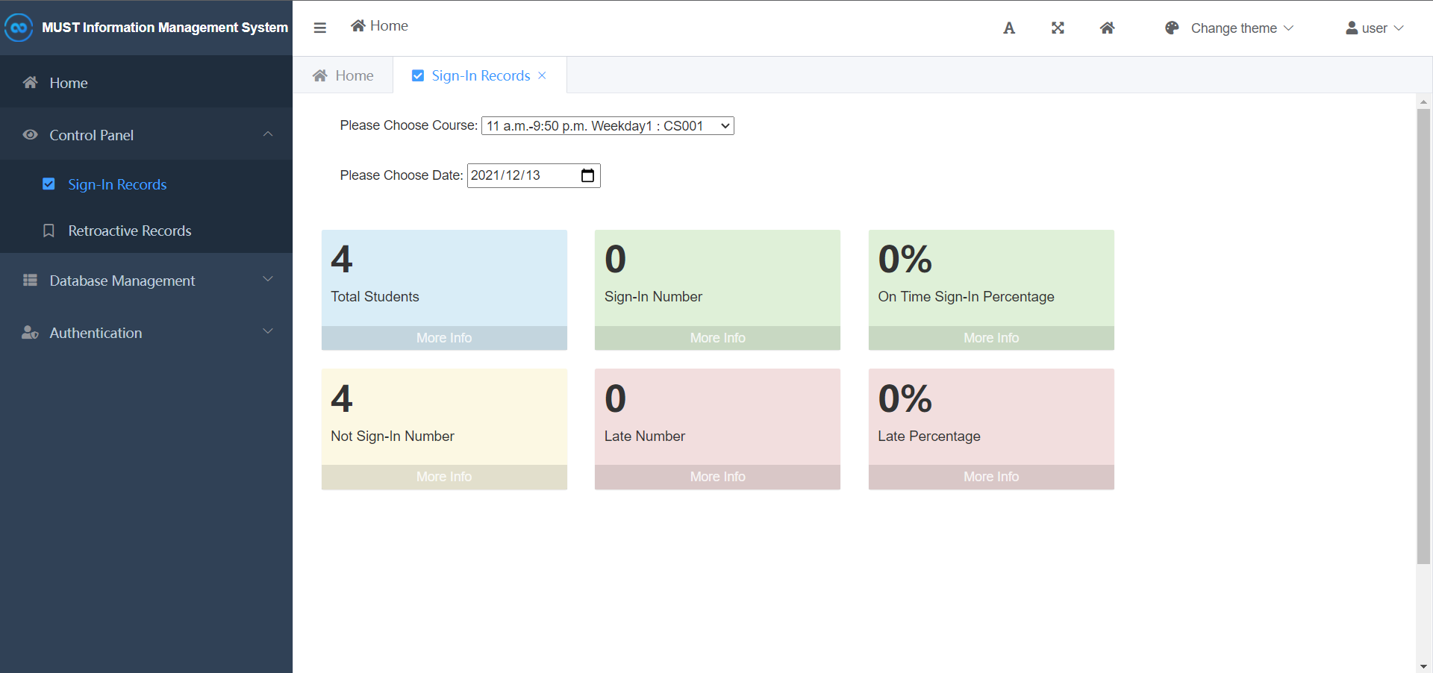
Project
Demo Meeting – Sprint 2

Slide 35
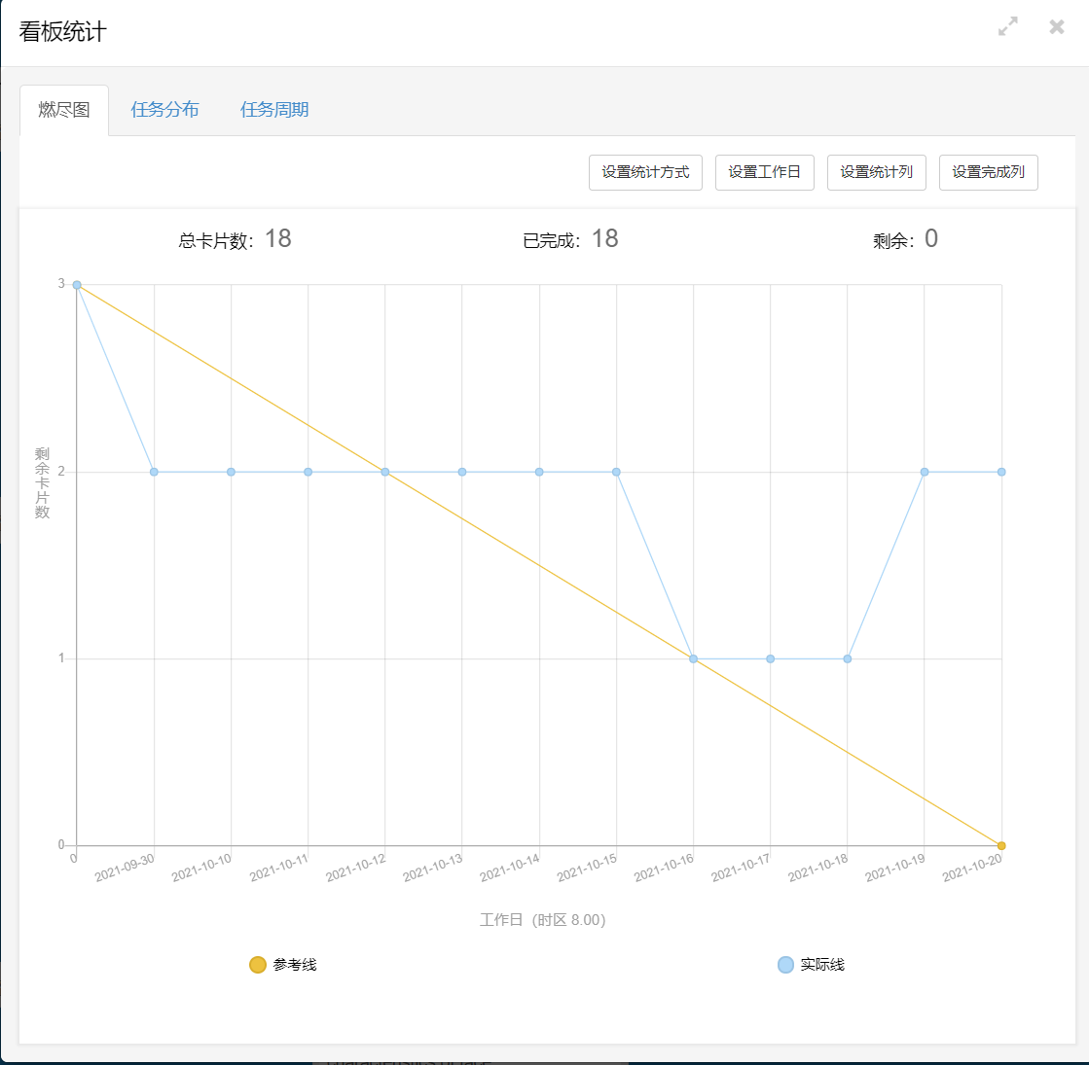
Project
Retrospective Meeting - Burndown Chart

Slide 36
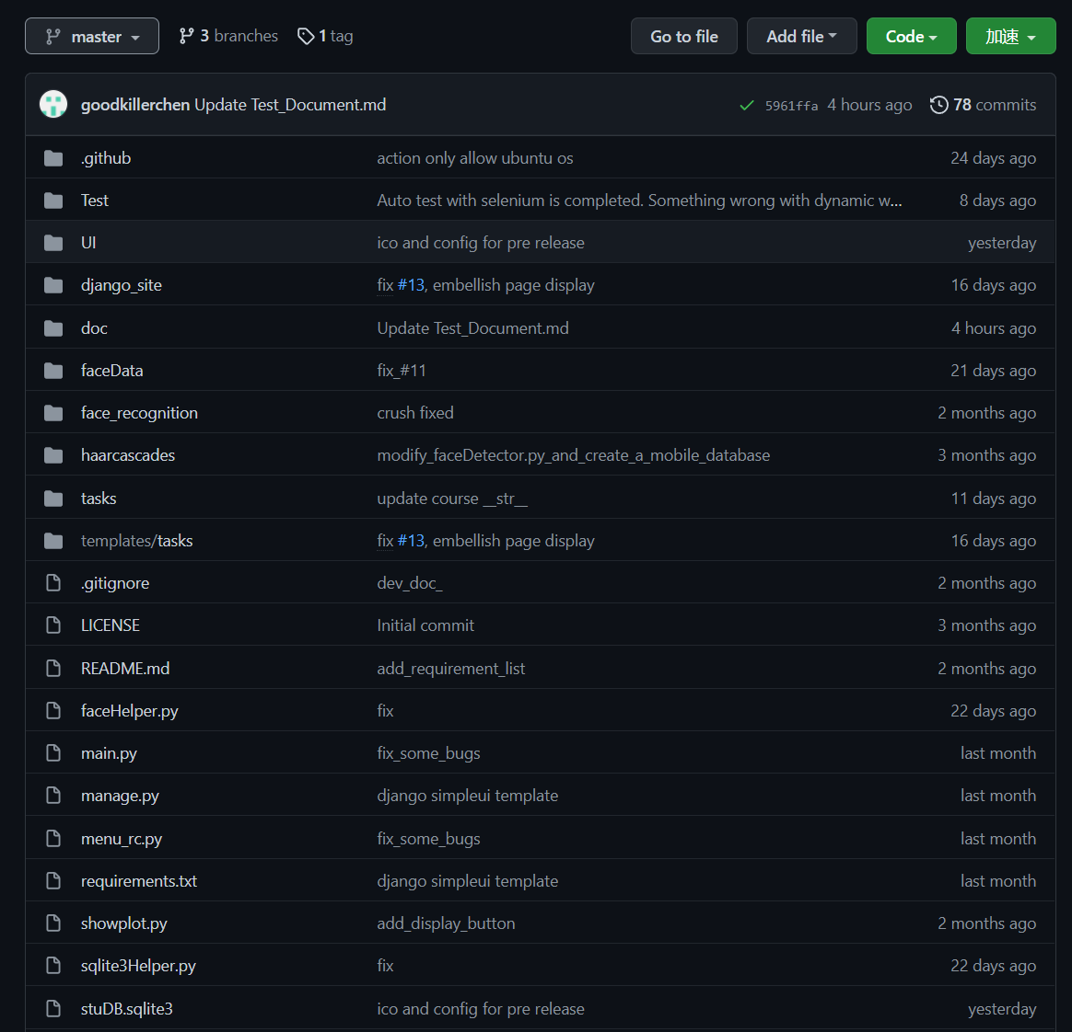
Project
Retrospective Meeting - Commit Message Improvement
After
Before

Slide 37
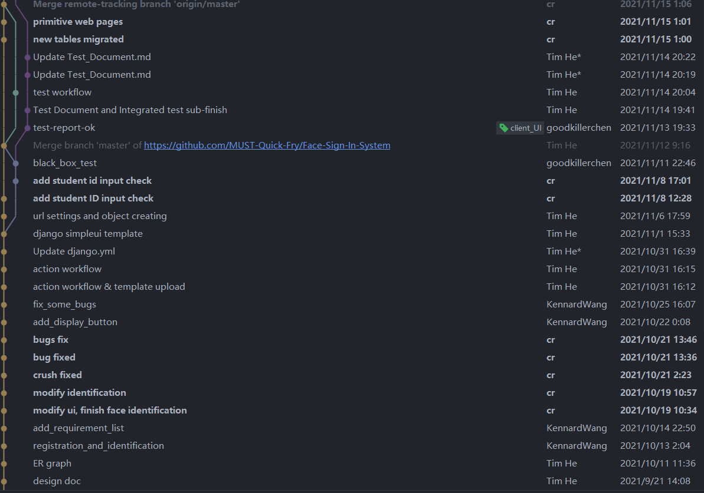
Project
Retrospective Meeting - Git Branch Improvement
After
Before

Slide 38
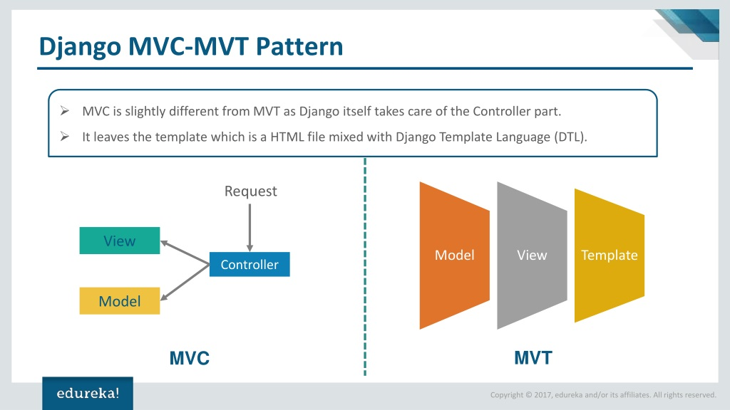
Project
Retrospective Meeting - Pattern Framwork Improvement
Before
After
Chaos
Low readability
Hard to locate bug
Notes:
开发进度、开会效率、文档书写

Slide 39
Testing
Black-box Test
White-box Test
Unit Test & Integration Test
Automation Test

Slide 40
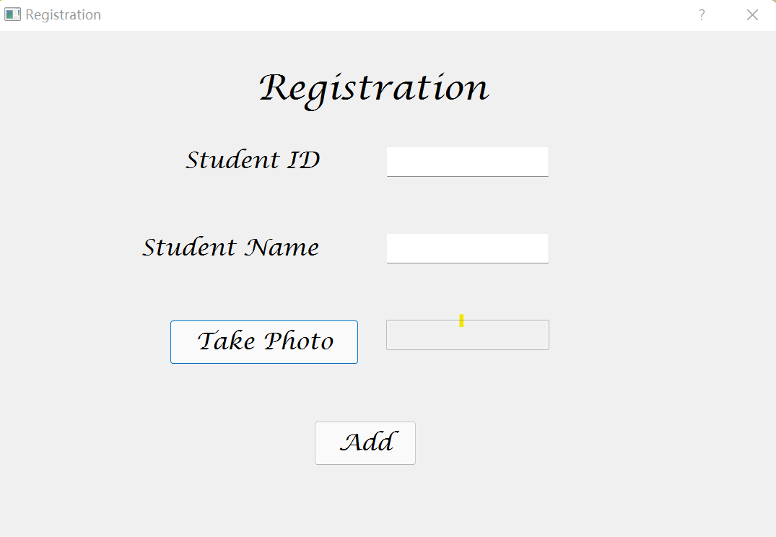
Black-box Test
Black-box Test
Equivalence Partition
M1 = {input sid valid}
M2 = {input sid invalid}
M3 = {input sid null}
D1 = {input sname valid}
D2 = {input sname invalid}
D3 = {input sname null}

Slide 41
Black-box Test
Boundary Value Analysis
Student id (fixed 16) : (^[0-9]{4}853[a-zA-Z0-9]{5}[0-9]{4}$)
✔ Valid input: 1809853zi0110099 (length: 16)
❌ Invalid input: 1809853zi011009 (length: 15)
❌ Invalid input: 1809853zi01100901 (length: 17)
❌ Invalid input: 1809😂😂😂😂 (format fail)
Student name : ([a-zA-Z]{2,20})
✔ Valid input: cr (length:2)
✔ Valid input: Romanadveratrelunder (length:20)
✔ Valid input: WangYuYang (length:10)
❌ Invalid input: a (length:1)
❌ Invalid input: Polyentolyekmongtainh (length:21)
❌ Invalid input: (^-^)(^-^)(^-^) (format fail)

Slide 42
Black-box Test
Decision Table
Condition Stub
C1: input sid in {M1,M2,M3}
C2: input sname in {D1,D2,D3}
C3: whether take photo in {yes, no}
C4: press the add button
Action Stub
A1: registration success
A2: Error exception

Slide 43
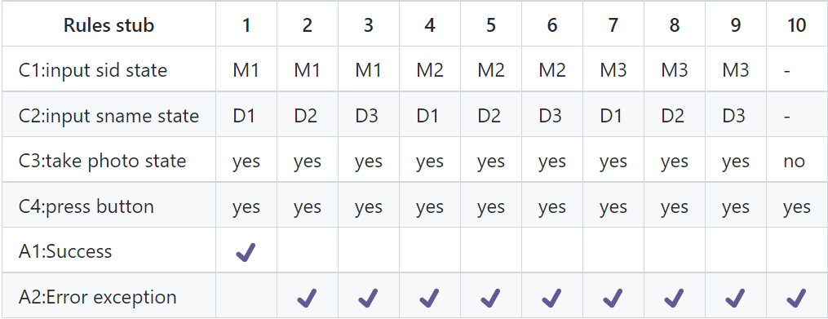
Black-box Test
Decision Table

Slide 44
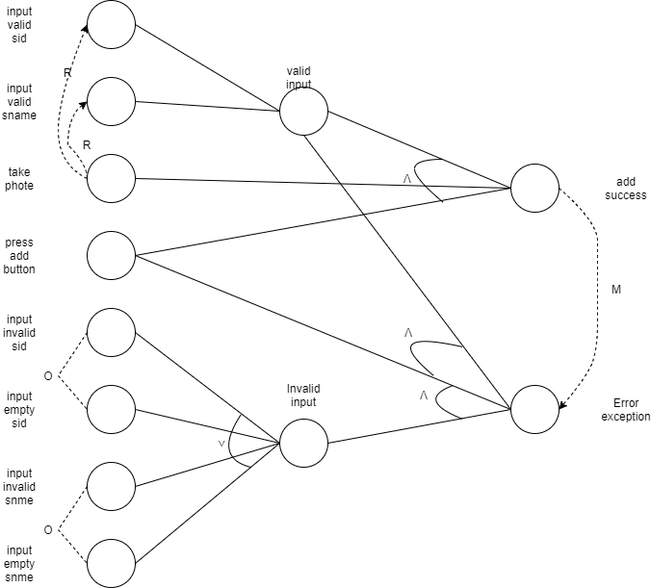
Black-box Test
Effect Diagram

Slide 45
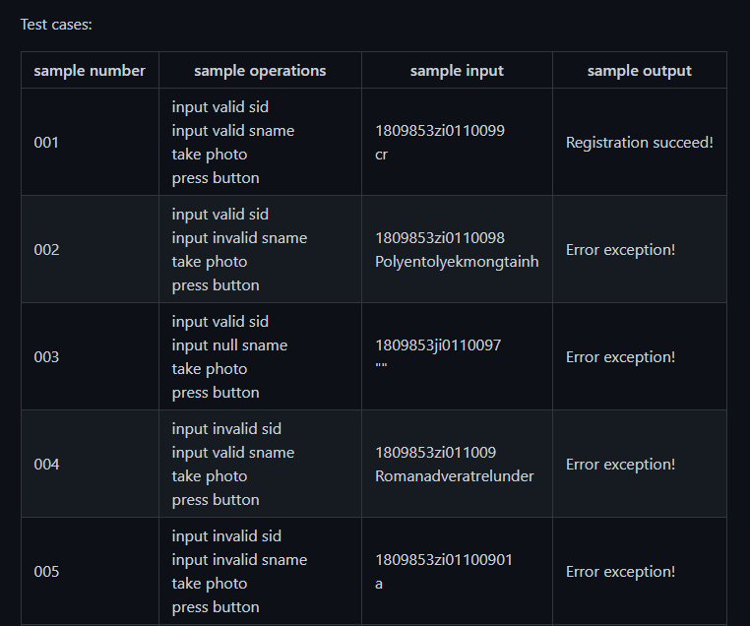
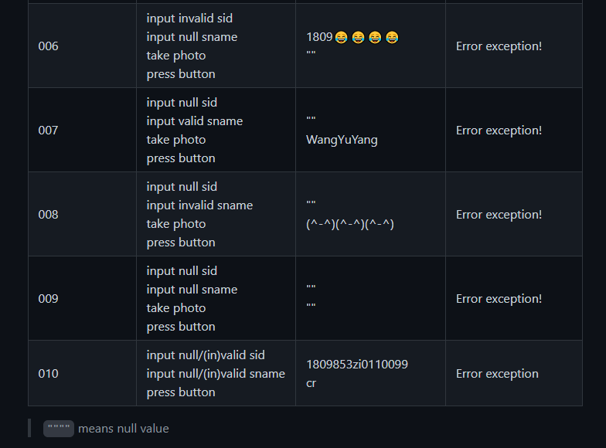
Black-box Test
Test Cases

Slide 46
White-box Test
White-box Test
Static White-box Test
Dynamic White-box Test

Slide 47

White-box Test
Static Test Tool - Pylint
Fix static logic-bugs
Identify code styles

Slide 48
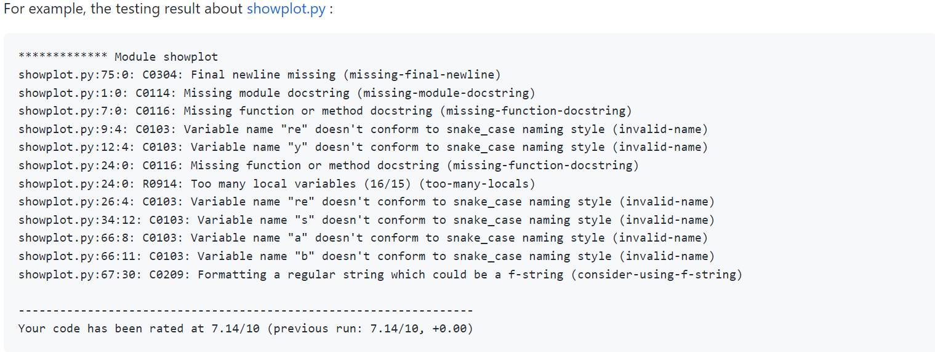
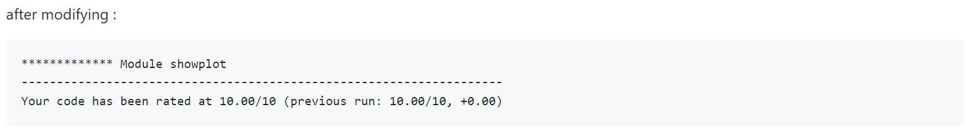
White-box Test
Desk Checking - Pylint

Slide 49
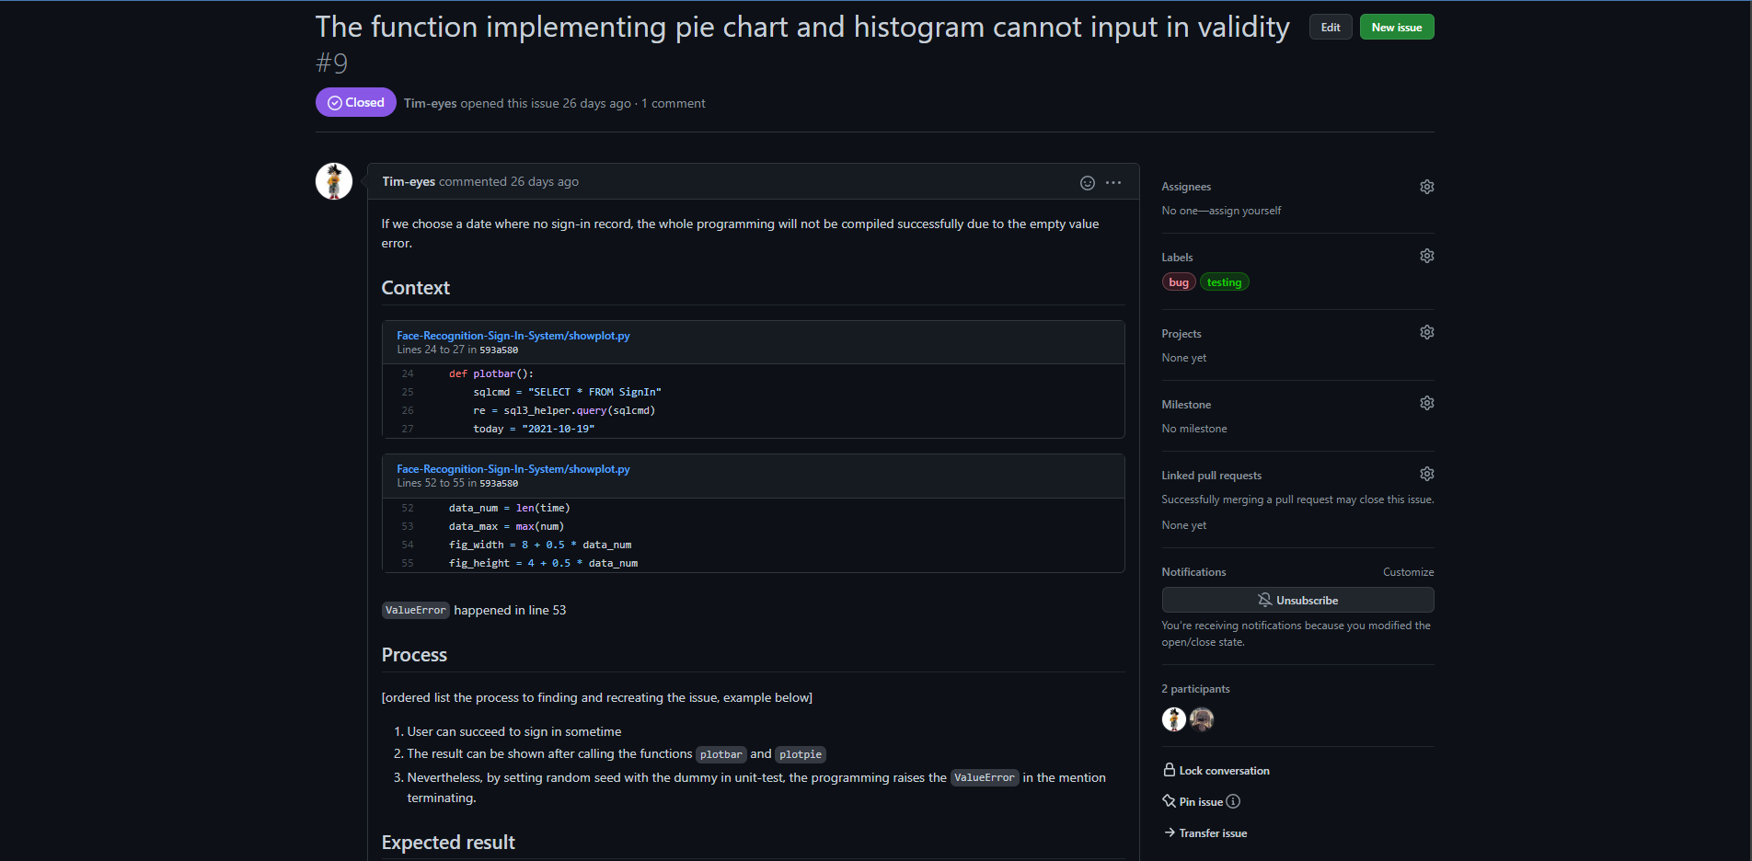
White-box Test
Colleague Inspection

Slide 50
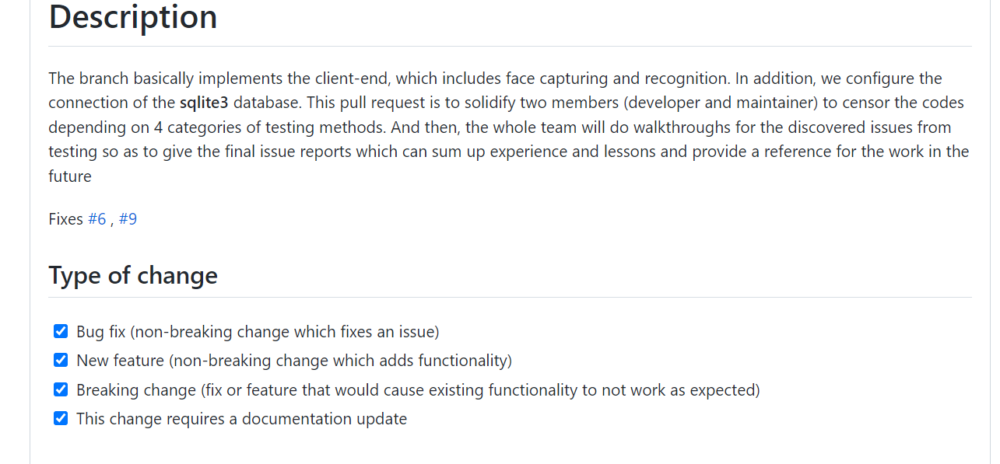
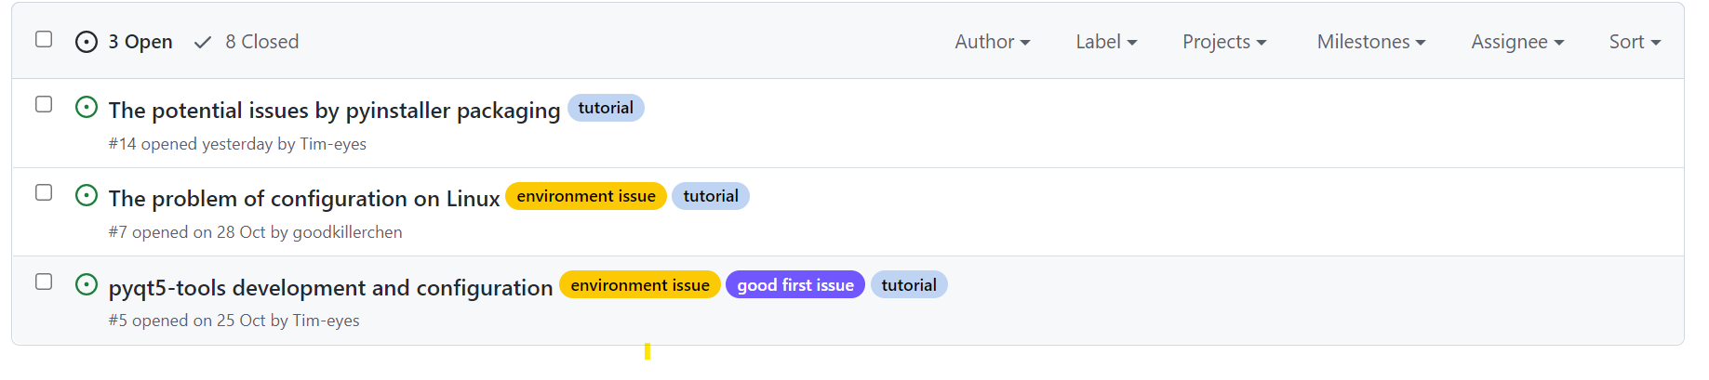
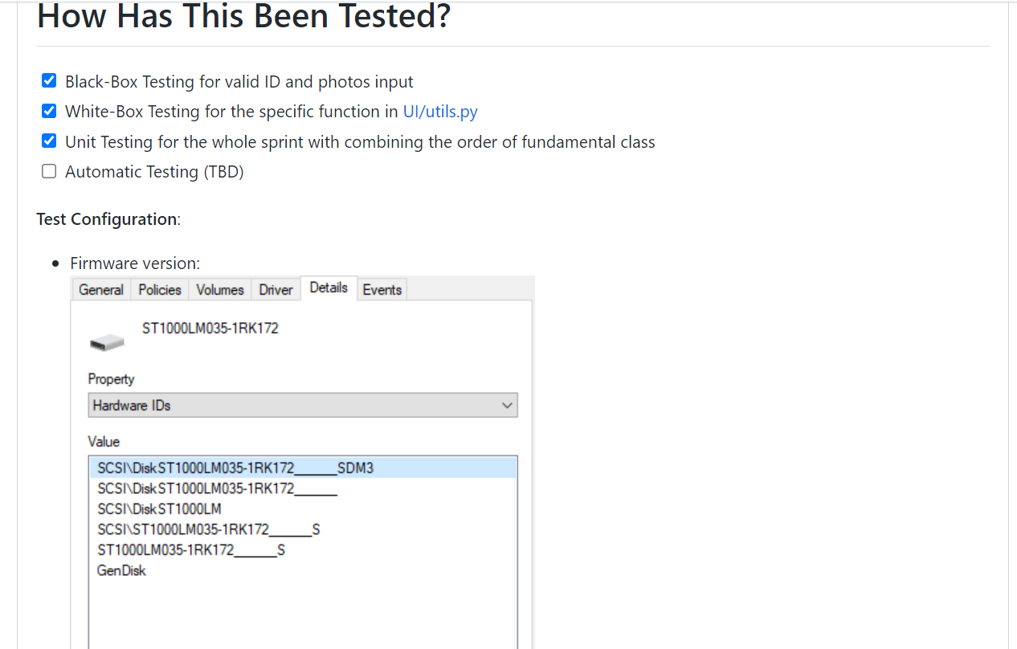
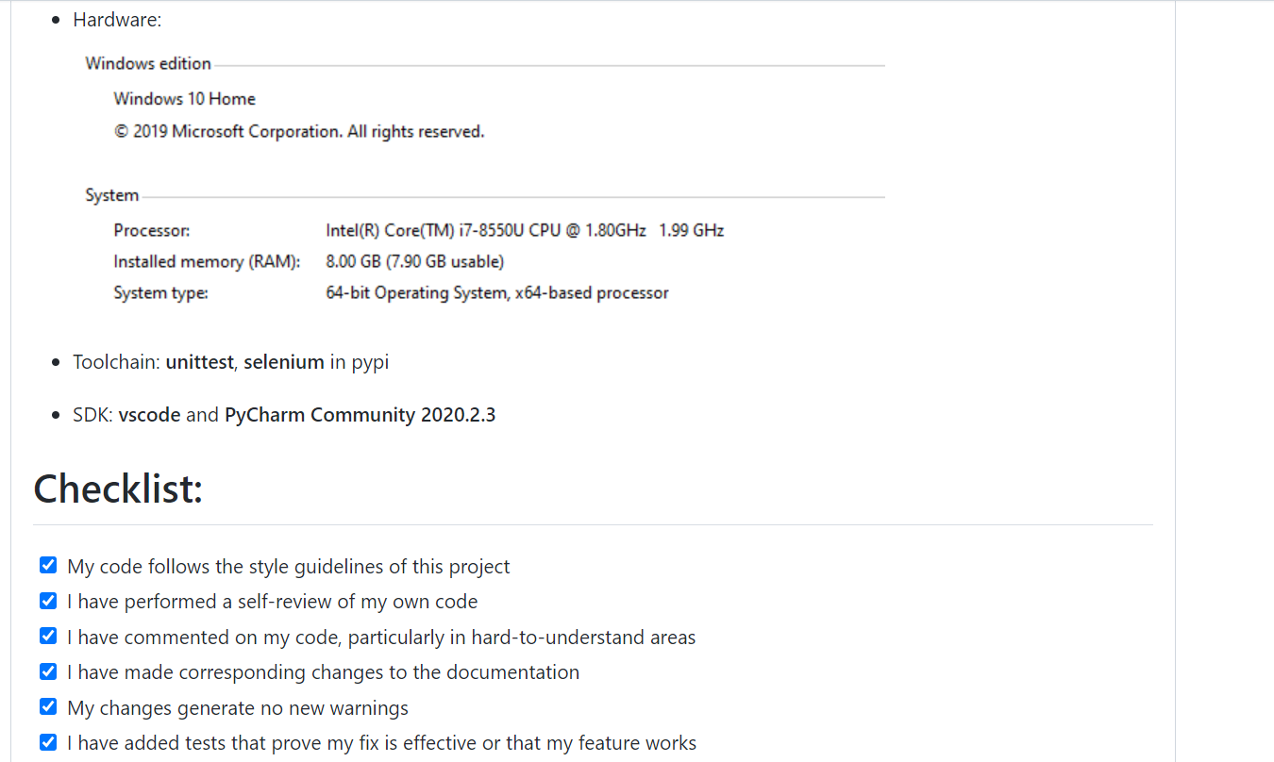
White-box Test
Code Walkthrough

Slide 51
White-box Test
Dynamic White-box Test
Statement coverage
Decision coverage
Condition coverage
Decision/condition coverage
Combination coverage
Independent path

Slide 52
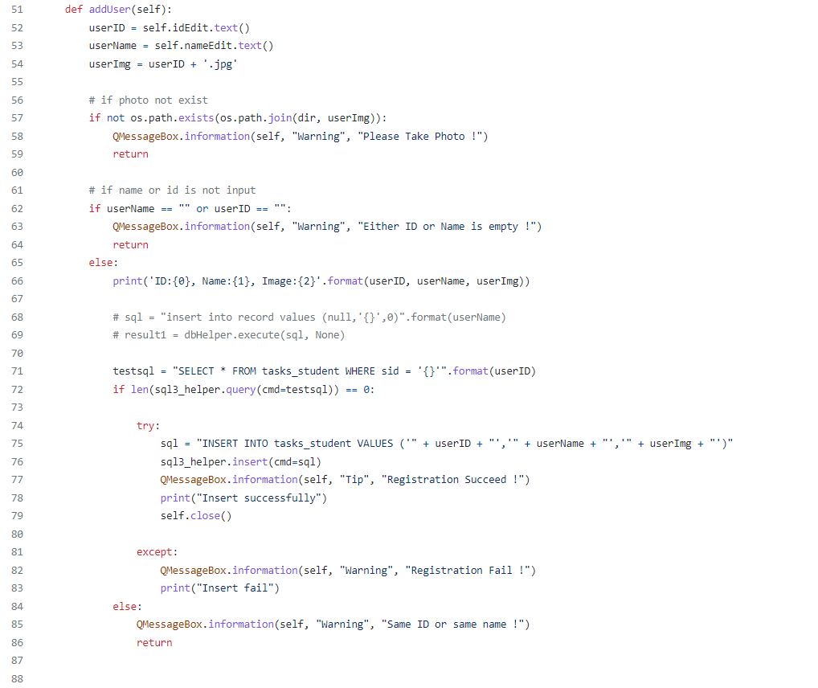
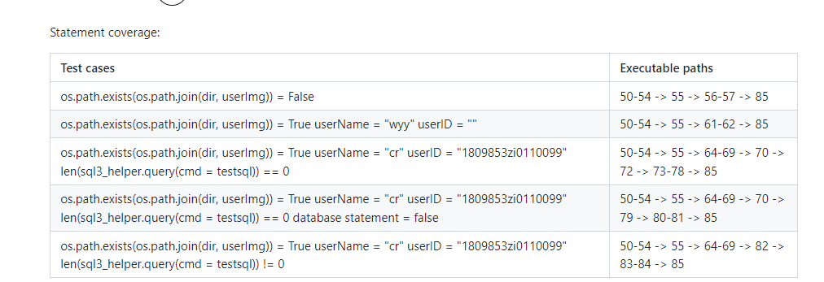
White-box Test
Statement & Decision Coverage

Slide 53
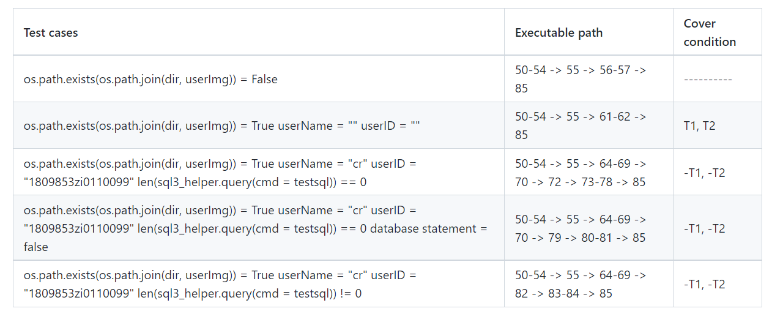
White-box Test
Decision/Condition Coverage
if userName == "" or userID == ""
userName = "" is true : T1
else : -T1
userId = "" is true : T2
else : -T2

Slide 54
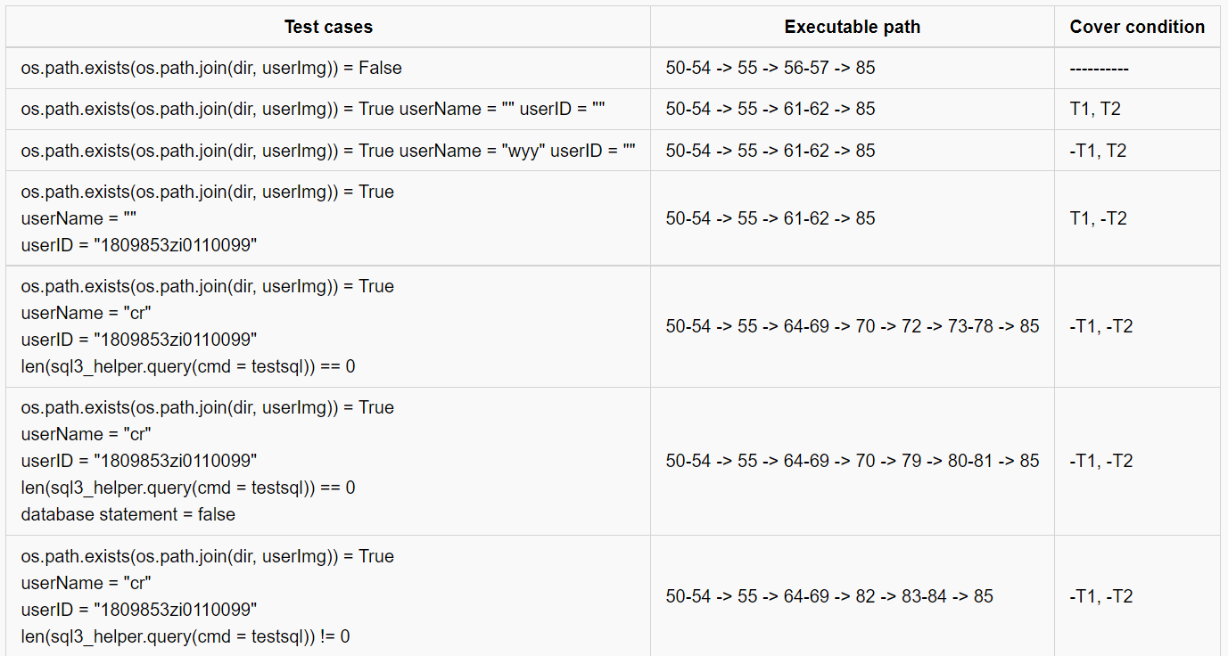
White-box Test
Combination Coverage

Slide 55
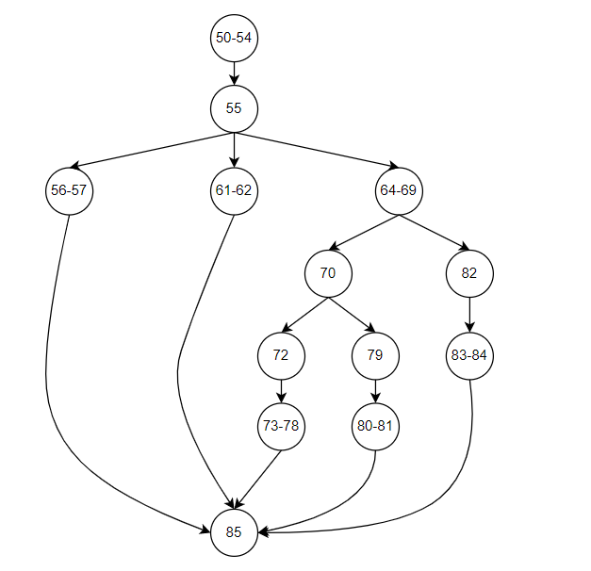
White-box Test
Control Flow Graph
The loop complexity is 5
Independent Path
50-54 -> 55 -> 56-57 -> 85
50-54 -> 55 -> 61-62 -> 85
50-54 -> 55 -> 64-69 -> 70 -> 72 -> 73-78 -> 85
50-54 -> 55 -> 64-69 -> 70 -> 79 -> 80-81 -> 85
50-54 -> 55 -> 64-69 -> 82 -> 83-84 -> 85

Slide 56
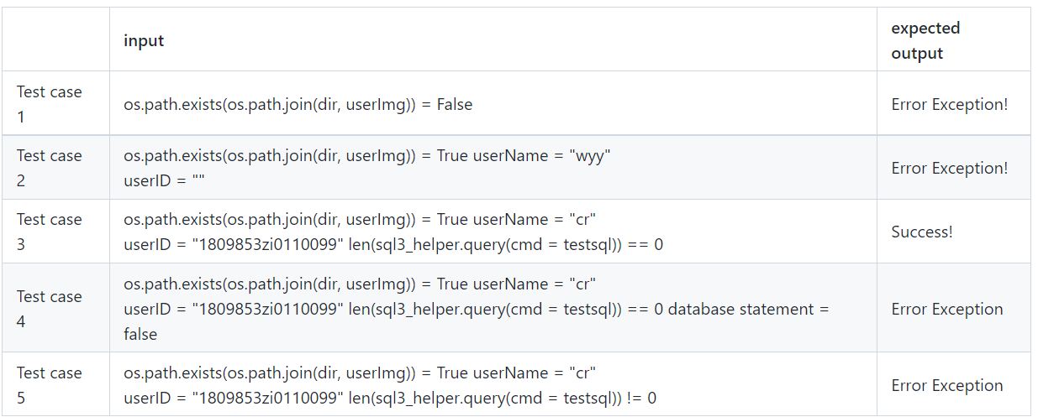
White-box Test
Test cases

Slide 57
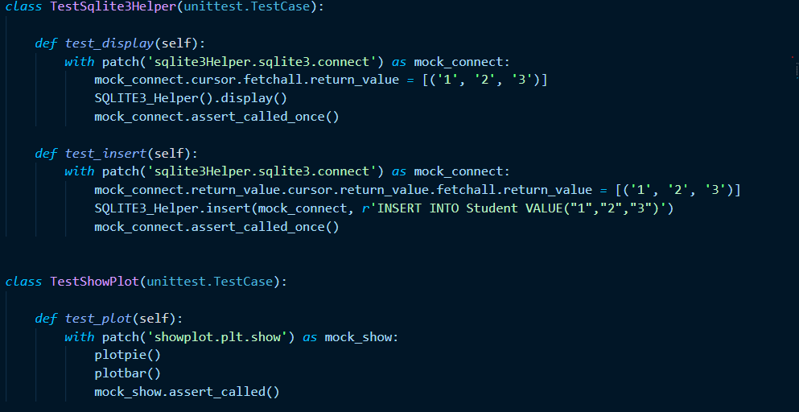
Unit Test & Integration Test
Unit Test & Integration Test
Unit Test
Mainly testing for sprint1 – Client UI
Test double : Mock
Integration Test
Run all part of unit test cases
Define and package the test suit
Testing fundamental interfaces of sqlite3 DB and statistic function

Slide 58
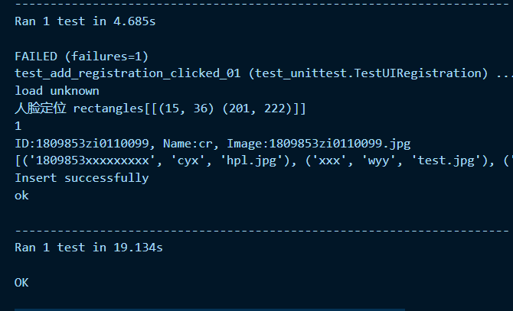
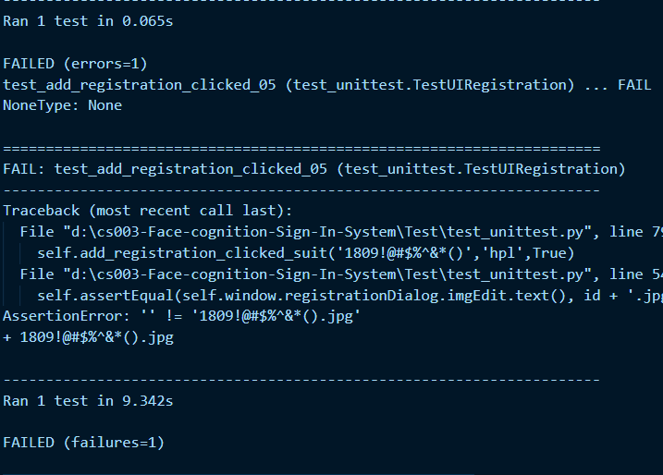
Unit Test & Integration Test
Testing the cases generated by Black-Box and White-Box
Test Case #1 with valid result
Test Case #5 with invalid result
Message from Python Testing Log

Slide 59
Automation Test
Automation Test Tool - Selenium
Login
Retroactive records
Show records
Add/Cancel/Search course/teacher/student
Change password
It will be shown later !

Slide 60
Management
Team Structure
PERT Chart
Gantt Chart
Software Quality Assurance

Slide 61
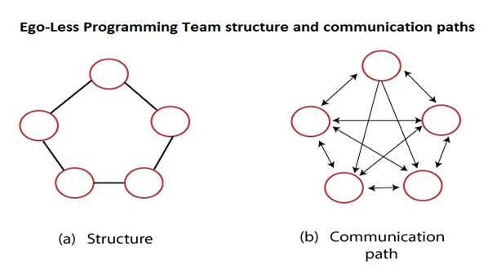
Team Structure
Team Structure - Egoless
Our software engineering team is organized within an egoless and democratic management module.

Slide 62
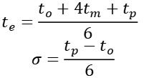
PERT Chart
PERT Chart
$$t_{e}=\frac{t_{o}+4t_{m}+t_{p}}{6}$$
$$σ=\frac{t_{p}−t_{o}}{6}$$

Slide 63
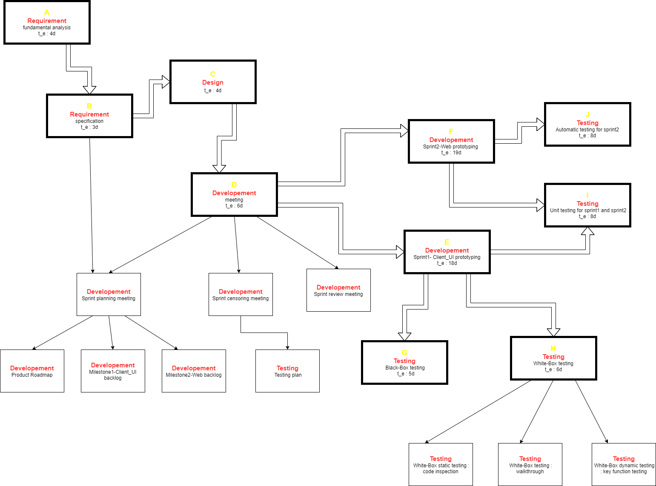
PERT Chart
PERT Chart

Slide 64
Gantt Chart
Gantt Chart

Slide 65

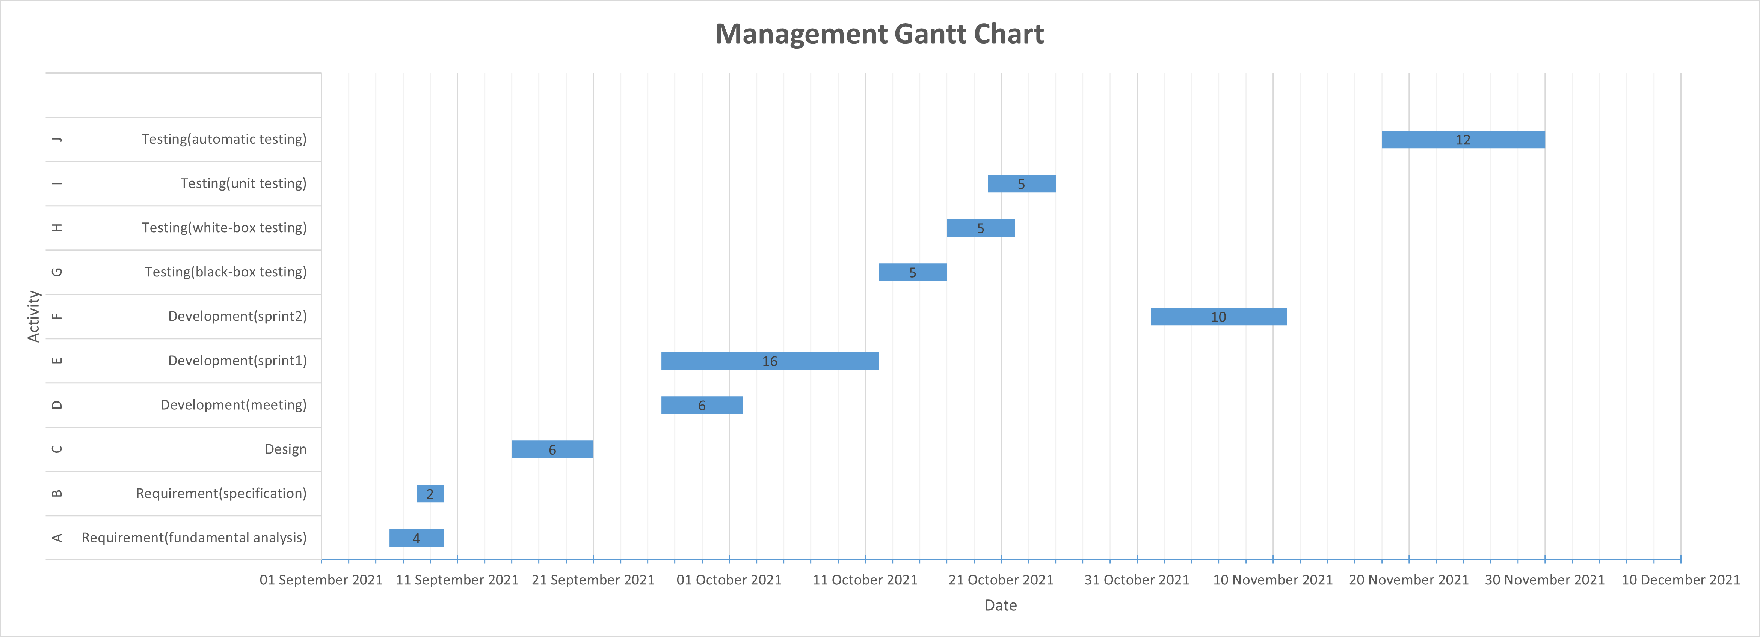
Gantt Chart
Gantt Chart

Slide 66
Software Quality Assurance
Quality Assurance
CMM2 Model -- repeatable and owning project-level thinking.
Use the basic project management process to track the progress, function and quality of the project.
Previous project experience can be applied to the current project.
Use a certain degree of organization and basic software testing behaviors, such as software testing plans.
Test Case Key Process Area (KPA)

Slide 67
THANK YOU FOR YOUR GUIDANCE!

